Slide 1
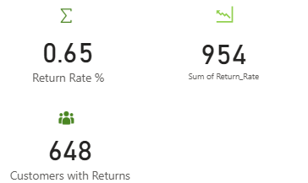
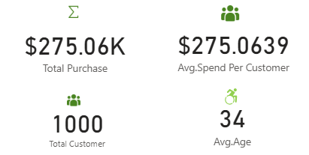



E-Commerce Store Performance Snapshot

Slide 2
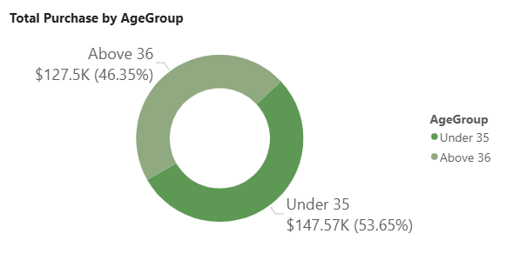
Customers under 35 years old contribute the highest purchase with $147.57k ( 53.65%) of total spend
Customers Above 36 spend less with $125.5k (46.35%)
This shows the youngers are buying more from the store

Slide 3
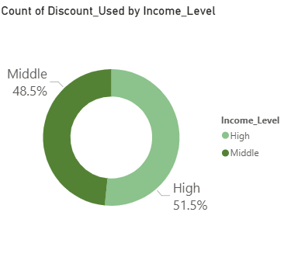
High-income customers use discounts most frequently and show a significant increase in spending during discount periods.
Middle-income customers use discounts less often and their spending remains stable regardless of discount offers.

Slide 4
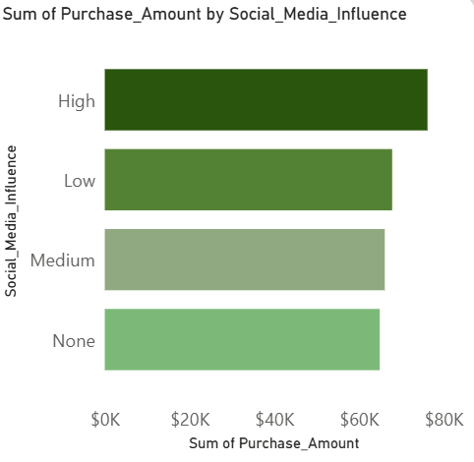
High social media influence customers generate the highest sales amount, indicating strong impact of digital engagement on revenue.
Low influence customers account for contribute steadily, showing limited conversion without engagement.
Medium influence customers contribute significantly

Slide 5
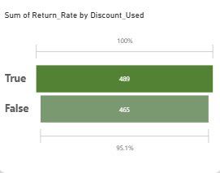
There is high number of return from the discount used

Slide 6
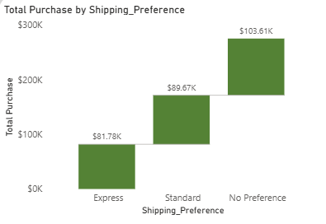
No preference have the highest shipping volumes.

Slide 7
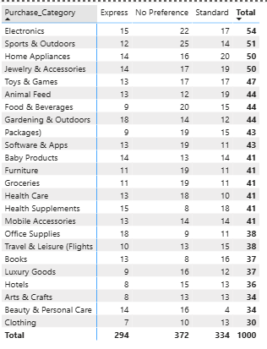
No Preference (372 orders) leads as the most used shipping option, followed by Standard (334) and Express (294)
Electronics (54 orders), Sports & Outdoors (51), and Home Appliances/Jewelry (50 each) are the top categories driving overall shipping demand.

Slide 8
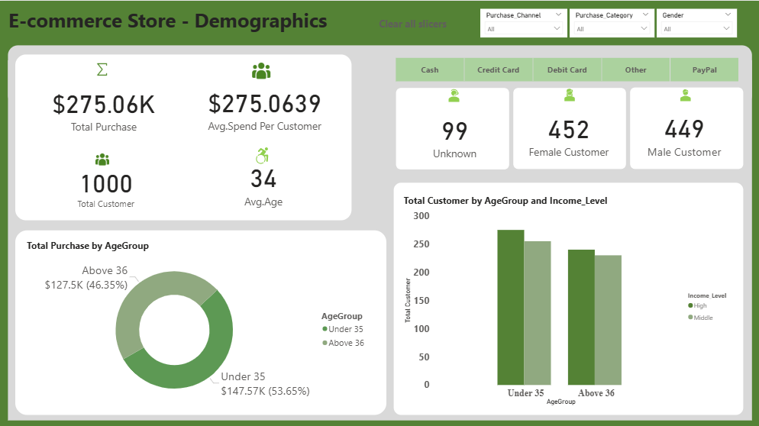

Slide 9
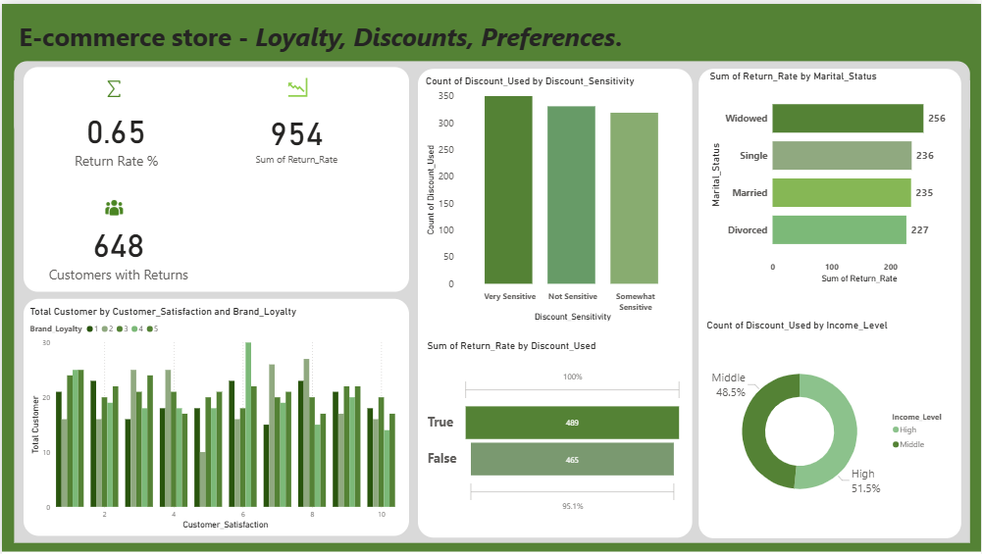

Slide 10
